Slide 1

LIBRARY MANAGEMENT SYSTEM WITH BARCODE USER COUNTER IN BISU-BILAR
Teofredo M. Gamale Jr.
Mary Joy C. Rubas
Berns Jordan S. Gerona

Slide 2
RATIONALE
Computerized applications have revolutionized the way academic institutions manage library materials and borrowers' information. BISU-Bilar College, a public institution in Zamora, Bilar, Bohol, has implemented a Library Management System with a Barcode User Counter to enhance its operations. This system provides real-time information on visitor numbers, stay durations, and library resources, aiding in hiring personnel, purchasing resources, and creating user-specific programs. It also enhances security by tracking material movement and preventing theft or unlawful borrowing. The Barcode User Counter also simplifies authentication for various services, reducing the need for manual intervention. Unlike traditional methods like human headcounts and paper sign-in sheets, the Barcode User Counter uses technology to track library usage. Patrons scan their barcodes at checkpoints, logging their activity and providing a digital trail of user activity. This innovative approach improves library operations and user convenience.

Slide 3
STATEMENT OF THE PROBLEM
The study aimed to developed a Library Management System with Barcode User Counter in BISU-Bilar. In order to attain the main objective, the following questions must be answered:
What is the current process of BISU-Bilar Library?
What are the problems encountered in monitoring attendance and circulation of books in BISU-Bilar Library?
What features to be developed to enhance the current process in BISU-Bilar.
What is level of System Sustainability as perceived by the target users?

Slide 4
OBJECTIVES
The main objective is to design and develop a Library Management System with Barcode user counter in BISU-Bilar Specifically;
Computerized the attendance of the students and recording of the books to prevent losing and misplacement.
Ease of access by the prospective students for book checkouts, returns of books.
Enhance the efficiency and accuracy of barcode scanning. This involves upgrading the scanning technology, ensuring compatibility with diverse barcode formats.
Instead of using files and folders, the database should be used to properly fill out the documents and files.
A fast processing in retrieving and storing of data.

Slide 5
SCOPE AND DELIMITATION
The study focused on the Library Management System with Barcode User Counter in BISU-Bilar Campus. The developed of the proposed system covered only the following process.
Borrowing/Return. The system would provide the management for borrowing/returning, damaged and lost of books/library materials.
Recording. This module include recording or updating the old or new data of the students who borrowed books and who enter the library within a month. This system also provides also the updating, Deleting and searching information.
Reports. It will involve data visualization of the statistical reporting technique. It will offer reports ready for printing tabular formats such as students’ daily attendance.
The scope of this study is defined by its focus on the Library Management System with Barcode user counter within the context of BISU-Bilar's library. The study encompasses various aspects related to the integration, its implications, and its impact on library operations and user experience.

Slide 6
SIGNIFICANCE OF THE STUDY
The Developed of the Library Management System with Barcode user counter in BISU-Bilar holds profound significance and implications for various stakeholders, including the library administration, staff, patrons, and the broader academic community.
Librarian. The librarian is the one who would manage the circulation of the library. The designed system would help the librarian an easy way of getting the numbers of visitors, monthly report, inventory reports and provide secure records about the books/library materials and borrowers information.
Staff. It will be easier for the staff to retrieve the records, and the work will be minimized. It will increase the morale of the staff using the computerized since it reflects technology advancement implemented by the students. The staff will also be responsible for entertaining the students to borrowed and check the book availability.
Library Users. Library users can experience the most convenient service, through fast and accurate of records in times of inquiry. The designed system would simplify the recording of information of library materials. IT would lessen the time retrieving of books information.
Researchers. The study would enhance their skills and knowledge in advanced technology by developing a system and becoming more aware of the existence and benefits of new technology.
Future Researchers. This research will be useful reference, and will further open doors for the future researchers to refine and expand in relation to library management system with barcode user counter.

Slide 7
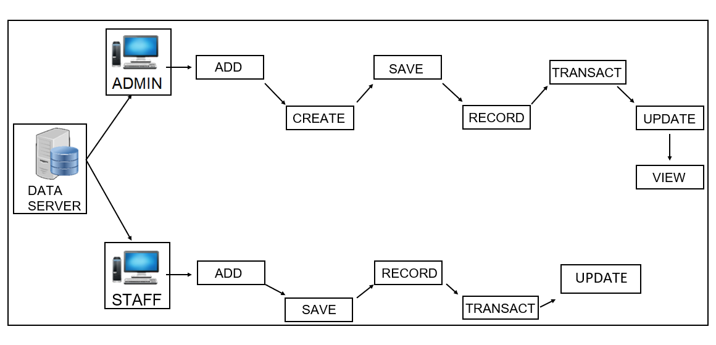
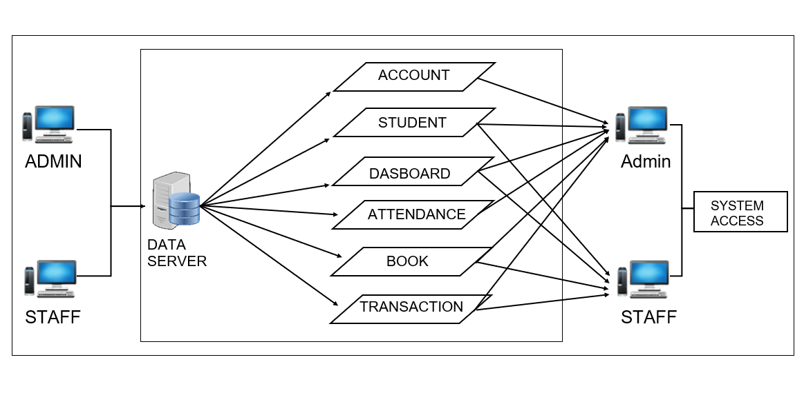
DEVELOPMENTAL FRAMEWORK
Figure 1. Conceptual Diagram of the Study
Figure 2. Block Diagram of the Proposed System

Slide 8
ENVIRONMENT AND PARTICIPANTS
The study was conducted at BISU-Bilar Library Campus, which is located at Zamora, Bilar, Bohol. The respondents of the study are the library staff, teachers, employees, visitors, students and librarian. The librarian and library staff are the one who handle the student manage library management system. To track and manage library user traffic and to enhance the library user counter.

Slide 9
DATA COLLECTION
The study initiated by the researchers began with a formal letter requesting permission from BISU-Bilar librarian. After that, they conducted face-to-face interviews with the librarian using a set of planned questions aiming to gain insights into the current operational; procedures at BISU-Bilar Library. The information obtained from these interviews was carefully documented. In addition to interviews, the researchers also undertook a thorough review of various documents. This included an examination of records such as the entering the library using barcode, borrowing books, which was essential for inputting data into the data design.
The Department of Computer Science is our respondents who rated the system usability assessment such as (1) Staff and (14) Students. Table 1 below presents the summary of respondents involved in the process.
Respondents | Frequency
Staff Students | 1 14
Total | 15
Table 1. Distribution of respondents in the system usability assessment

Slide 10
PRESENTATION, ANALYSIS AND INTERPRETATION OF DATA

Slide 11
EXISTING OPERATION AND PROCESSES
The BISU-Bilar Library is still using the manual process in processing library management system and the students do manually write the details like information. The school Librarian manually monitor of the status of the number students who entered library and to Manage the library. The staff will assist the students who borrowed books.
Attendance
Students enter the library and write their information manually.
Borrow book
The admin or staff records the student's borrowing information manually in paper borrowing format.
Return book
The admin or staff manually checks the records of borrowed books listed in papers for returning transactions.
Penalties
The admin or staff manually creates the return date for the borrowed books.
Reports
The admin staff manually counts all the total data being recorded.

Slide 12
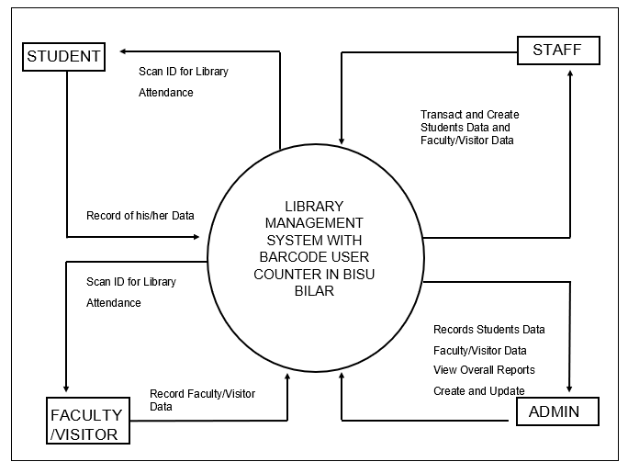
CONTEXT DIAGRAM OF THE PRESENT SYSTEM

Slide 13
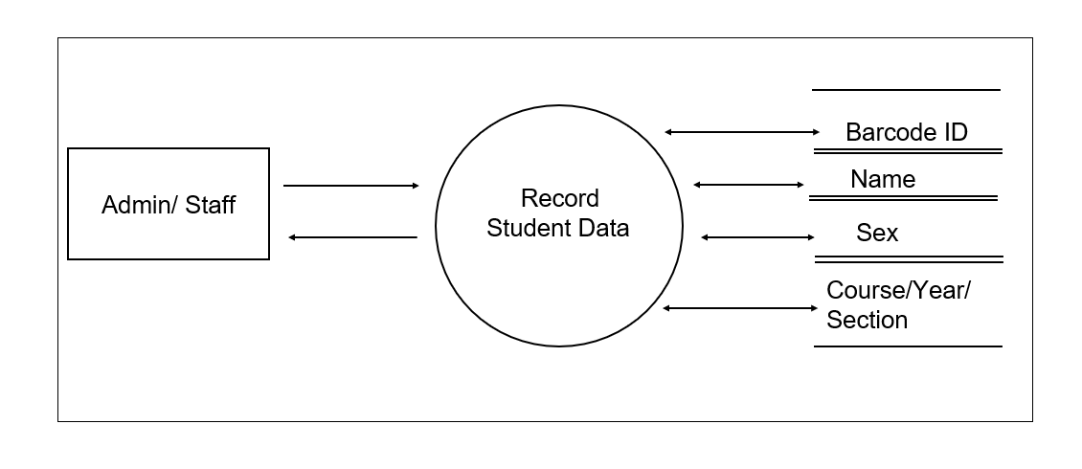
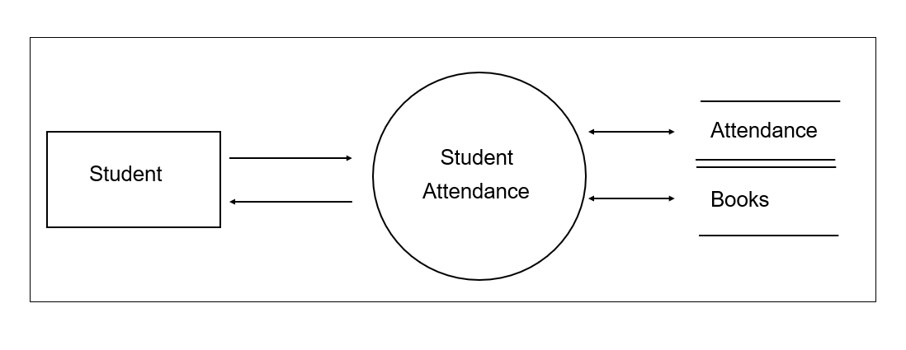
EVENT SPECIFICATION
department
Figure 4. Record Student Data (Event 1)
Figure 5. Student Attendance (Event 2)

Slide 14
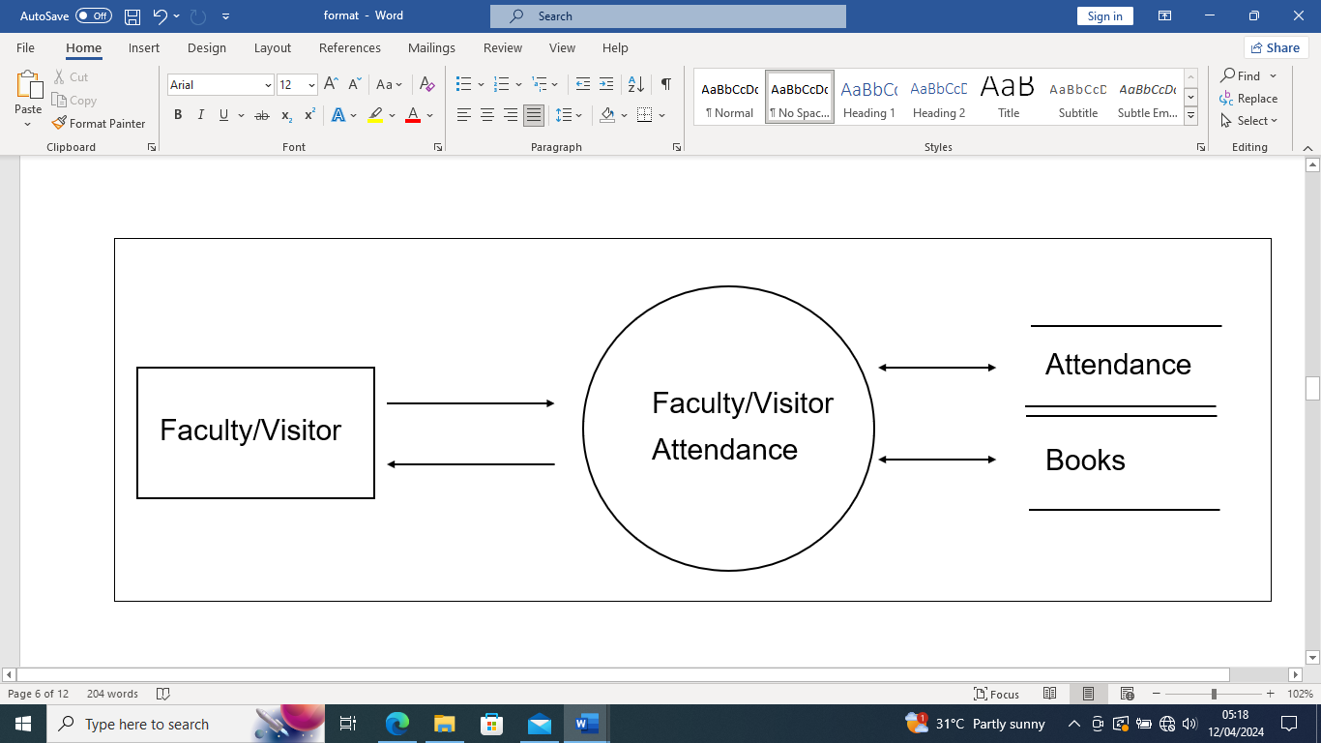
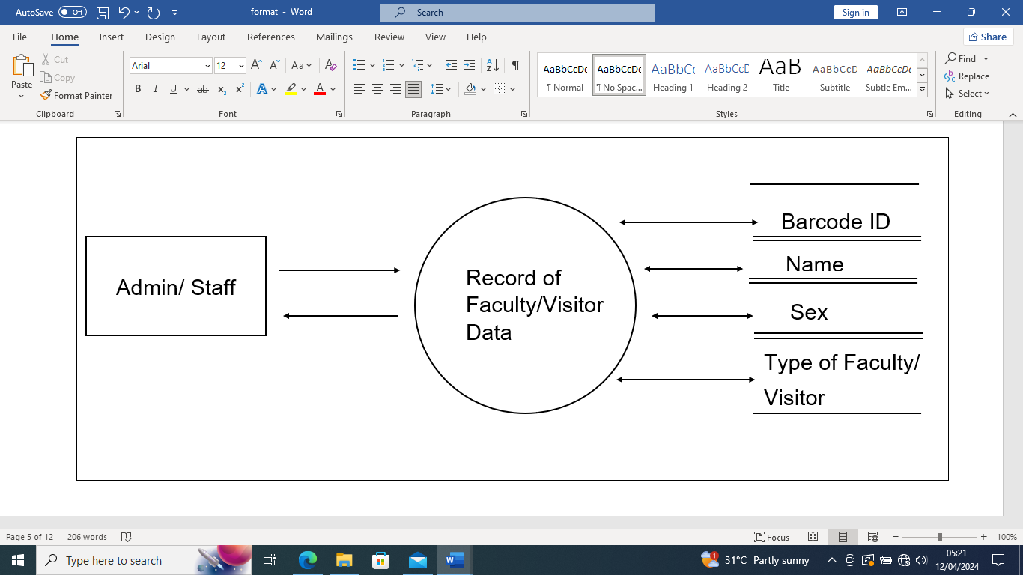
EVENT SPECIFICATION
Figure 6. Faculty/Visitor Attendance
Figure 7. Record of Faculty/Visitor Data

Slide 15
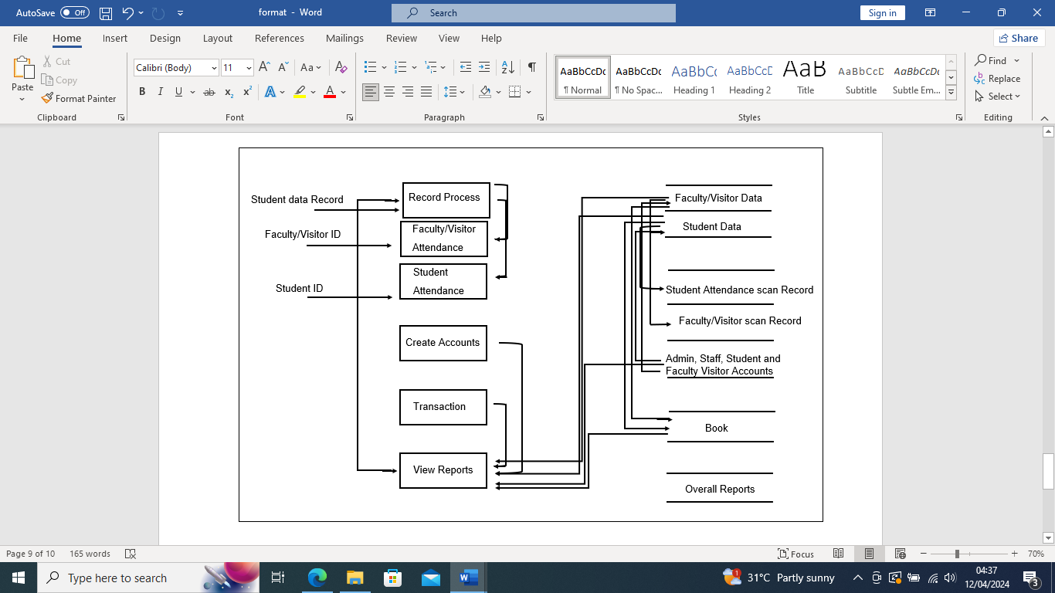
CONTEXT DIAGRAM OF THE PRESENT SYSTEM
Figure 10. Top Level of the Present System

Slide 16
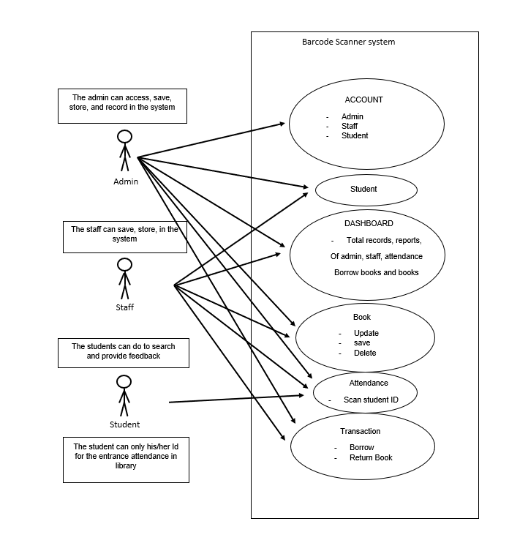
USE CASE DIAGRAM
A use case diagram, as a defines by Sunil (2023), is a visual representation within the Unified Modeling Language (UML) that illustrates the interaction between users (referred to as actors) and a system. This diagram effectively portrays the system’s functionality, aiding in the identification and management of project scope and facilitating communication with stakeholders. In figure 9, a use case diagram is presented, illustrating three users: a Librarian, Staff and Students. The librarian manage the system, while staff is to assist the student to the scan the barcode, Students.
Faculty/Visitor
The Faculty/Visitor can scan his/her id for entrance attendance

Slide 17
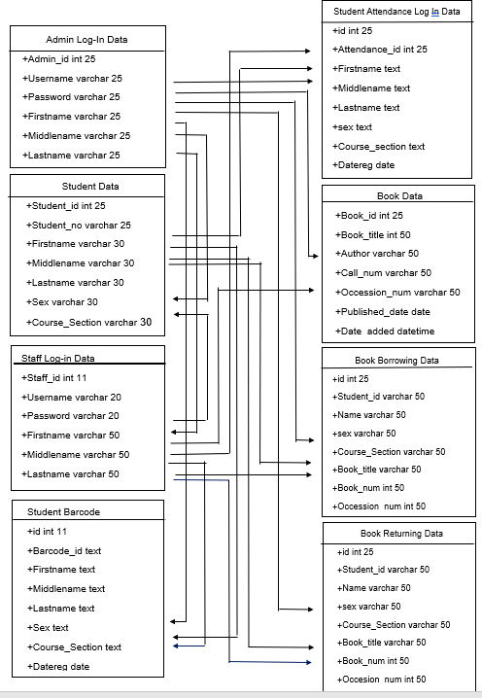
CLASS DIAGRAM
Class diagram in the United Modern Language (UML) is a type of static structure diagram that describes the structures of a system by showing the systems classes, their attributes, operational methods, and the relationships among objects.

Slide 18
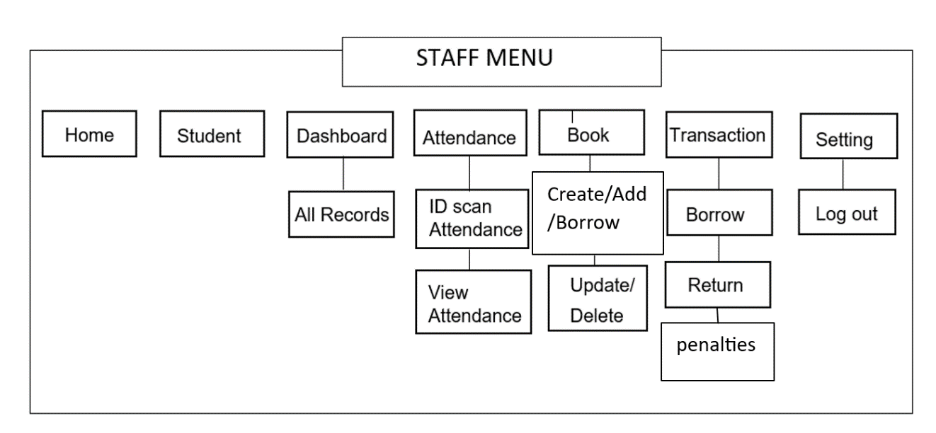
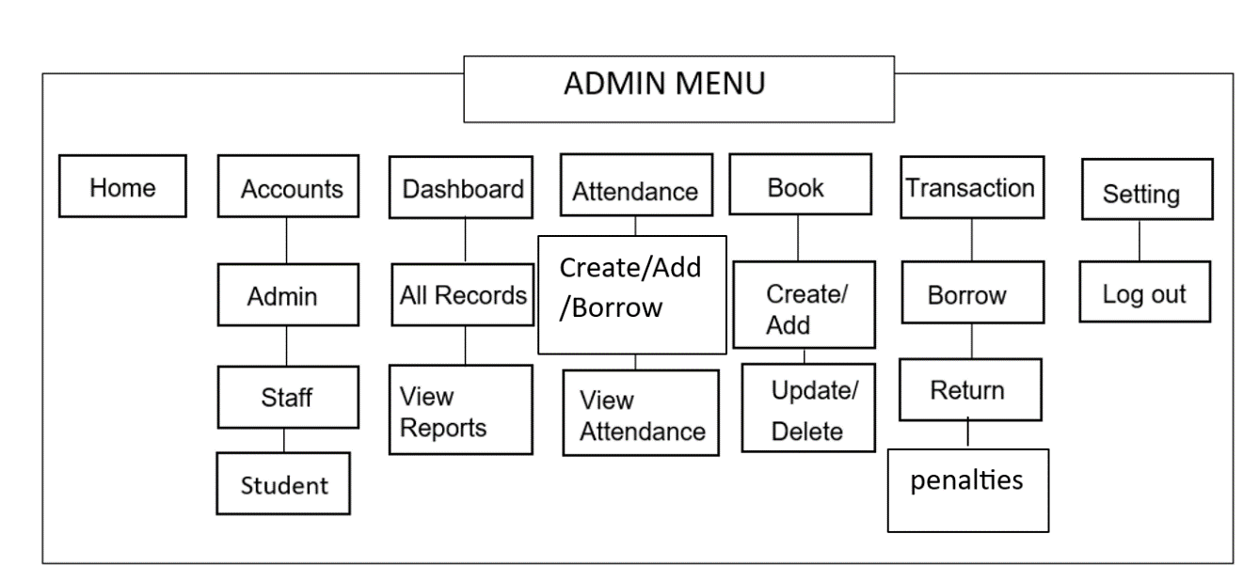
Program Hierarchy
Faculty/Visitor

Slide 19
SUMMARY OF FINDINGS, CONCLUSION, AND RECOMMENDATIONS
The institution uses semi-manual processes for managing library information, leading to issues like misplacement, attendance monitoring, and record duplication. To address these issues, a Library Management System with Barcode User Counter in BISU-Bilar was developed. The system includes modules like Accounts, Dashboard, Student Barcode ID, Incrementing Counter, Data Logging, and Transactions like borrowing and borrowed. The system was evaluated in terms of usability, with an average rating of 4.52, indicating the system meets individual expectations in terms of ease of use, visual clarity, and language.

Slide 20
CONCLUSION
Based on the findings of the study, the researchers have concluded that the concern institutions lack system, and there are problems encountered by the students in the process of the current attendance monitoring and library Management. Library Management System with Barcode User Counter in BISU-Bilar have improved the record management efficiency and attendance by scanning Barcode fitted the requirements and expectations of the client and adoption of the system requires minimal investment, operational cost, hence, affordable, and economical.

Slide 21
RECOMMENDATION
Based on the aforementioned conclusions, it is recommended that the developed system should be implemented at Library Management System with Barcode User Counter in BISU-Bilar, where the study is being done. The researchers came up with the following recommendations in order to resolve the needs identified during the study.
1. The future researchers can improve the efficiency and accuracy of library operations, making it easier for both students and staff to manage library resources effectively.
2. Researchers should consider incorporating data analytics capabilities into the system to analyze user behavior, optimize resource allocation, and continuously improve library services based on insights gained from usage patterns.
3. Researchers could explore the possibility of integrating the Library Management System with the institution's existing student information system or learning management system.

Slide 22



